Slide 1

DATA VIZUALIZATION DESIGN PROJECT 2024
MARKET PULSE: UNVEILING PRODUCT PERFORMANCE IN
E-COMMERCE
BY
ASSWIN KARUPPAIAH PL (21f1001419)
PRIYANKA NATHANI (21F1005807)
PURAVASU JAIDEEP SESHA(21f1000162)
Trivikram Umanath (21f1005359)
Team 6

Slide 2



INTRODUCTION

Slide 3



Data
Products
Categories
Indicators
The data contains 27555 products with their categories, ratings and number of reviews, along with the original and selling price.
Each category has its respective subcategories which help group the products. Each product is divided into types.
There are different indicators like seasonal, bundle and promotional, and customer demographics for each product.

Slide 4
BASIC PREPROCESSING

Slide 5


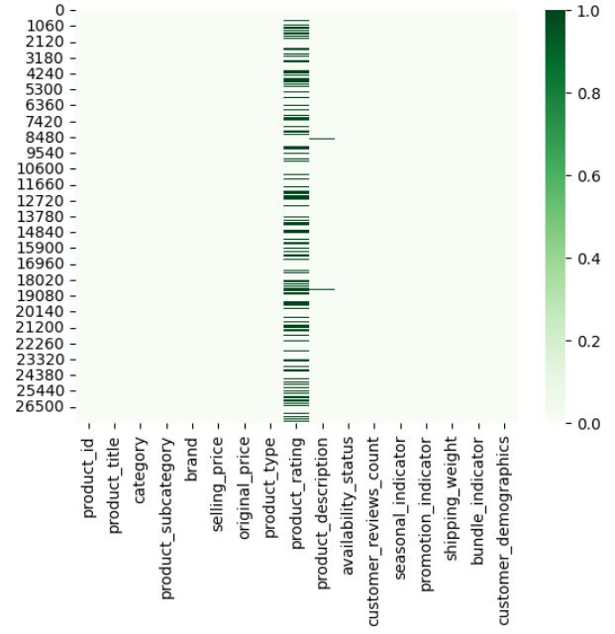




Data Cleaning
product_rating - 8626 missing values
Identified missing values
Filled missing values using interpolation
Data imputation
product_description-115 missing values
Dropped rows
Replaced with ‘Not available’
Replaced with placeholders.

Slide 6
EXPLORATORY DATA
Analysis

Slide 7
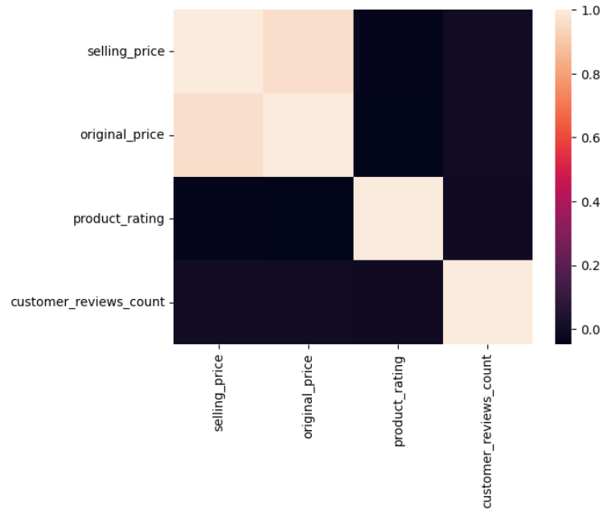


Product Distribution by Category
No correlation among the quantitative variables

Slide 8
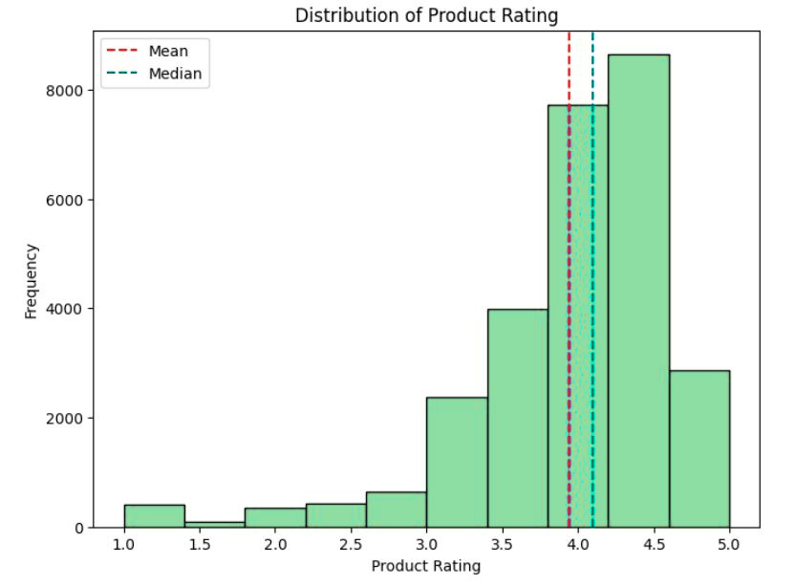
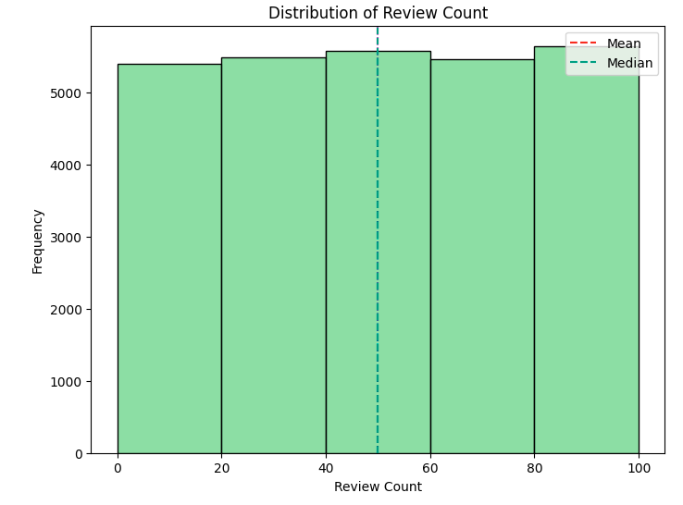
Distribution
4.1
49.96
3.94

Slide 9
BRAND & MARKET ANALYSIS

Slide 10
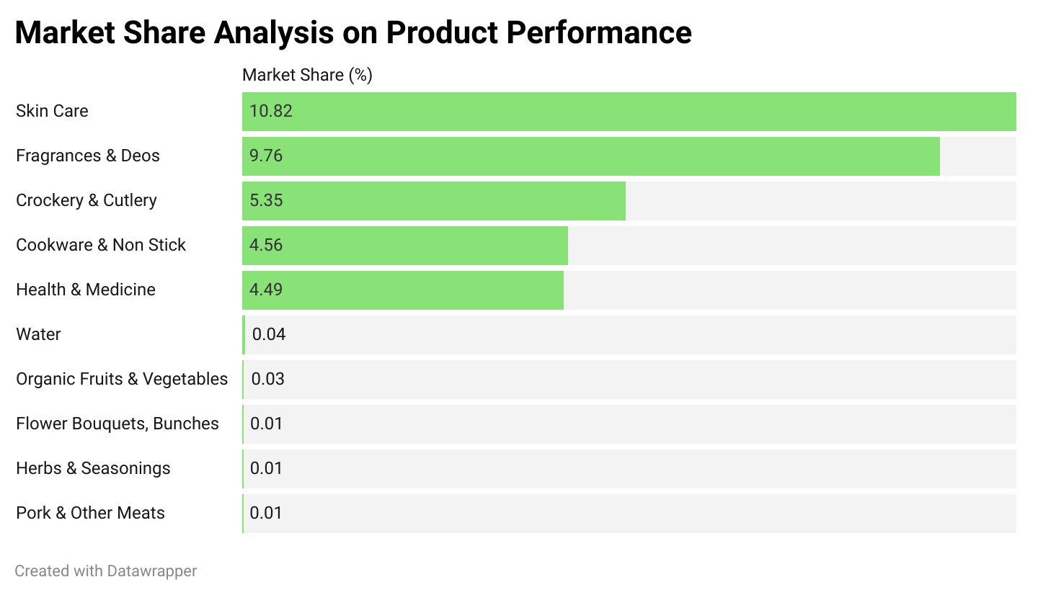


PRODUCT CATEGORY PERFORMANCE ANALYSIS
Top Performing
Products Sub
Categories
Poor Performing
Products Sub
Categories

Slide 11
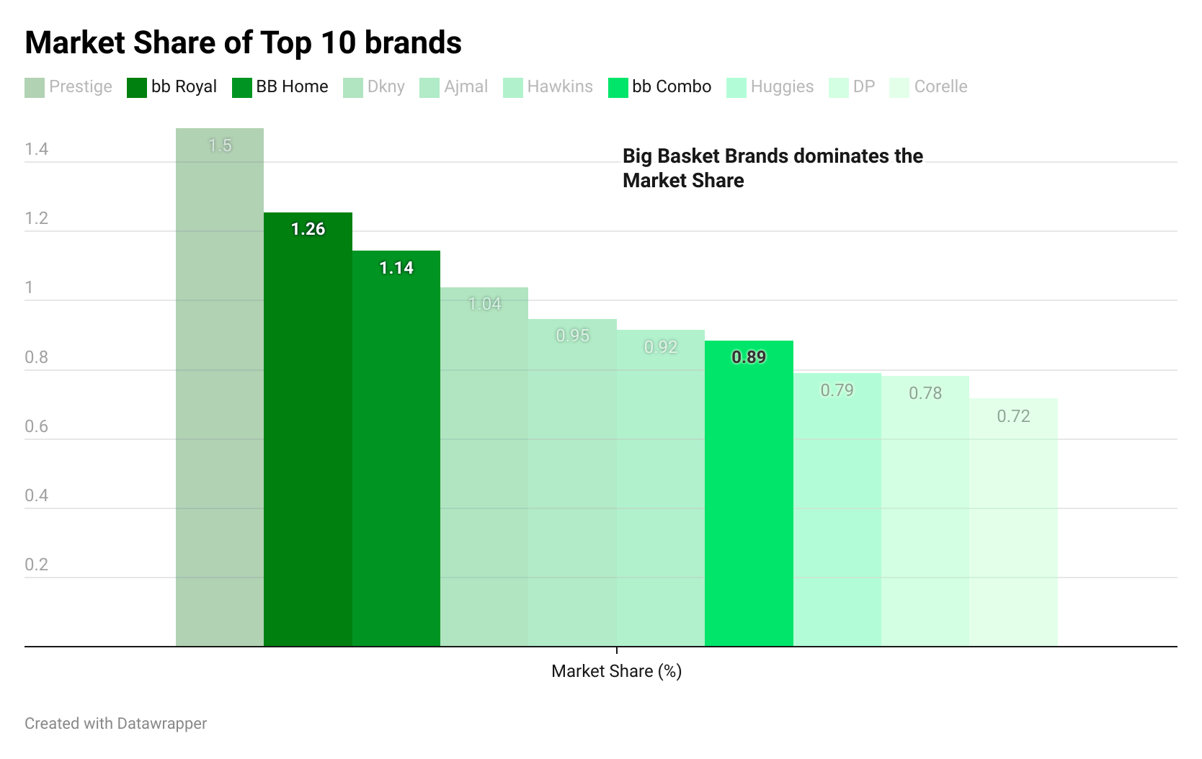
BRAND PERFORMANCE ANALYSIS

Slide 12
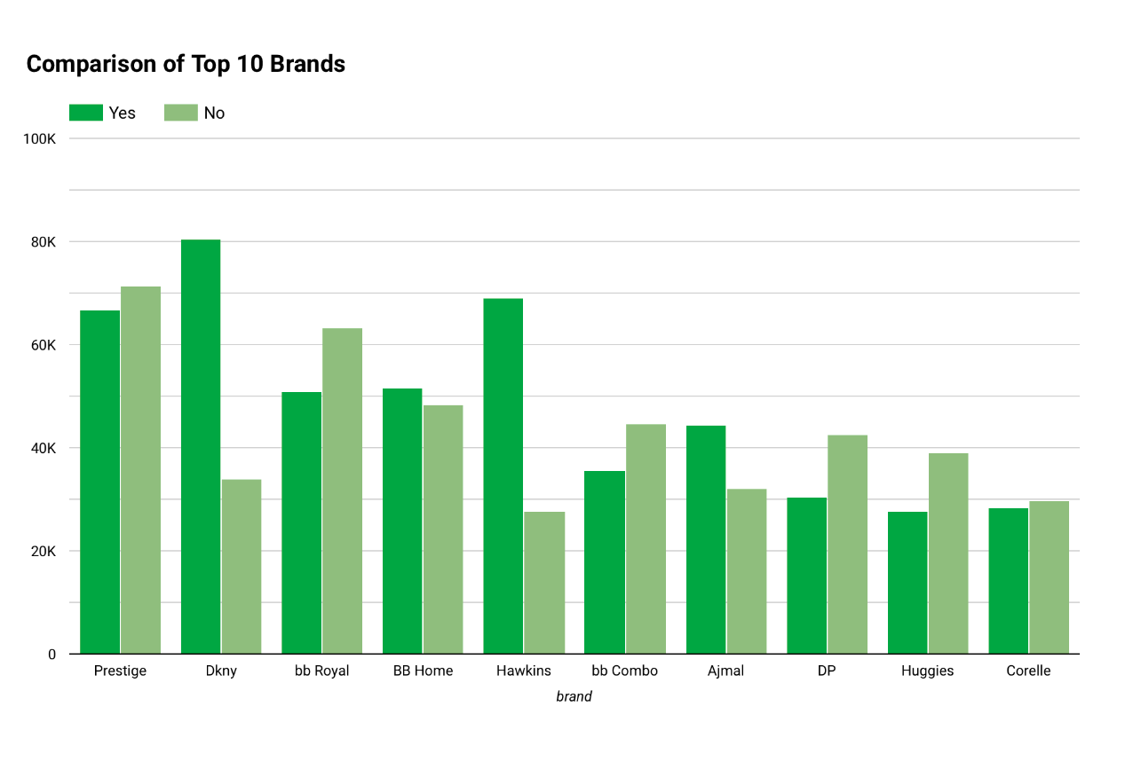


PROMOTIONAL INDICATOR ANALYSIS
Promotions significantly increase sales
Google Looker

Slide 13
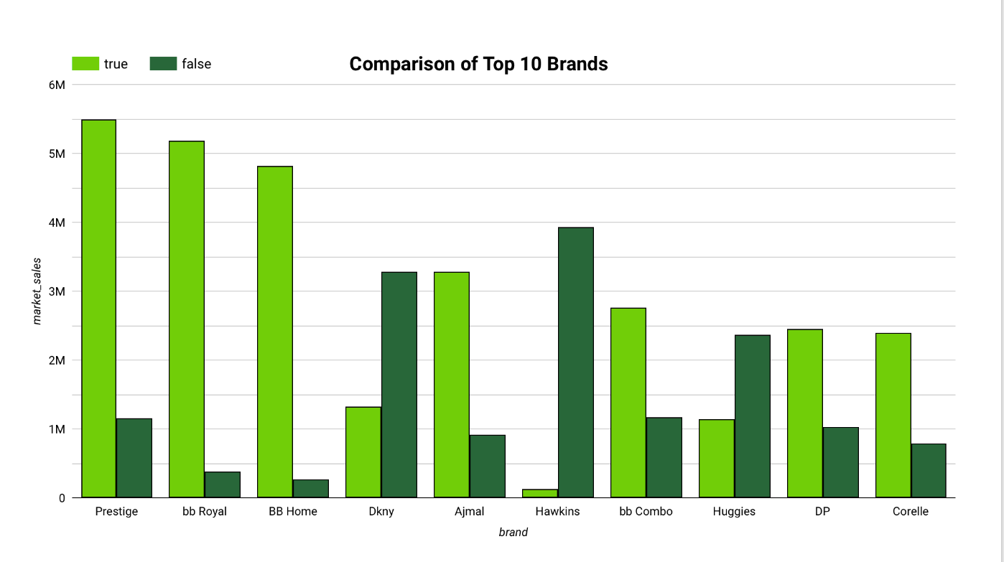
DISCOUNT INDICATOR ANALYSIS
Google Looker

Slide 14

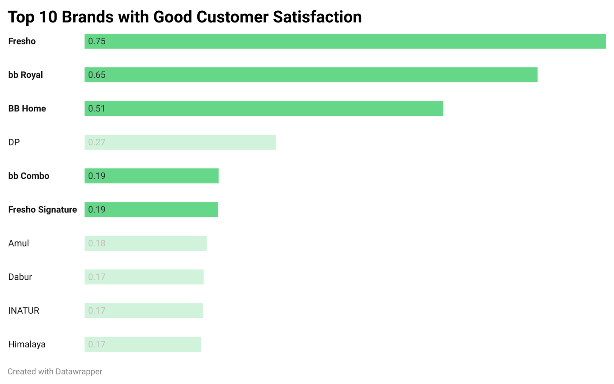
CUSTOMER SATISFACTION ANALYSIS
BIGBASKET BRANDS
EXCELS IN
SATISFACTION
Composite Score = Normalized Rating x Normalized Review Count

Slide 15


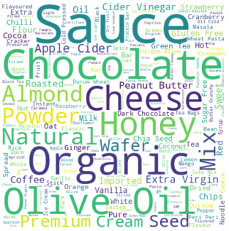
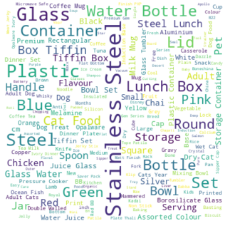
CUSTOMER PREFERENCES FOR TOP 3 CATEGORIES
Beauty & Hygiene
Gourmet & World Food
Kitchen, Garden & Pets
Oil
Skin
Hair
Sauce
Chocolate
Organic
Stainless Steel
Glass
Plastic

Slide 16
PRICING STRATEGIES & GROWTH OPPORTUNITIES

Slide 17
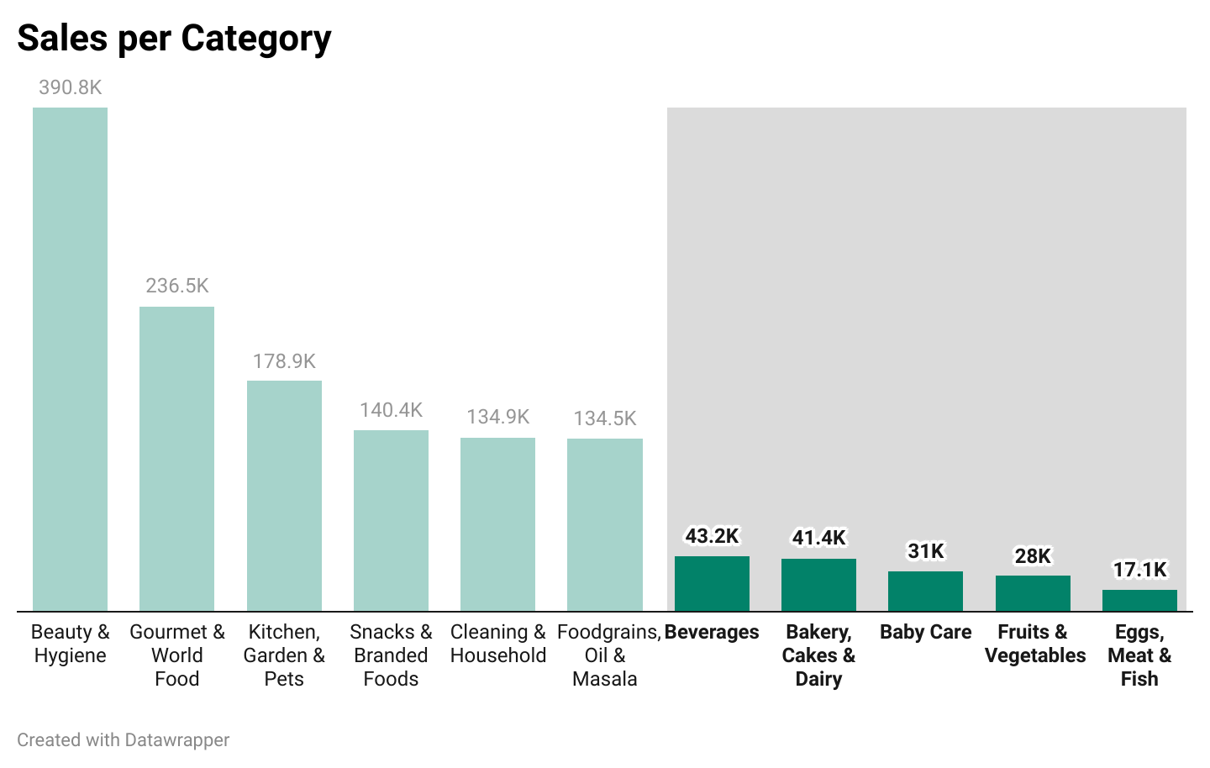

SALES ANALYSIS
Categories with alternate options

Slide 18


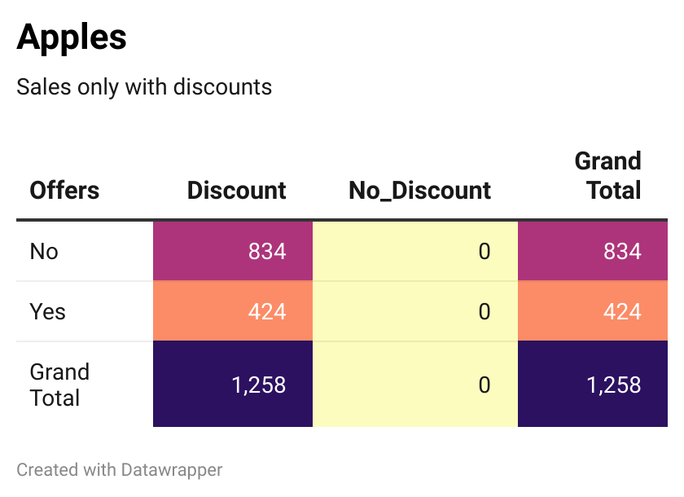
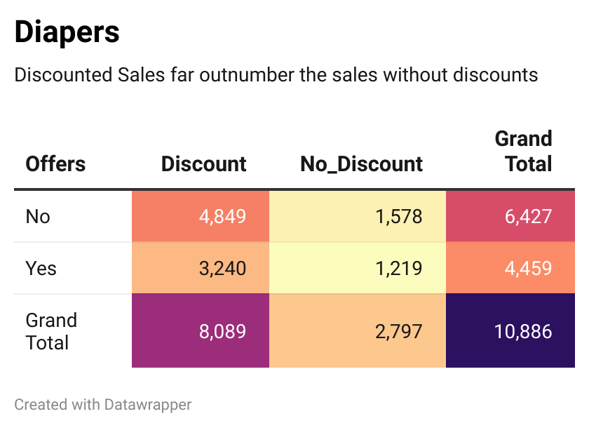
HEATMAPS FOR SALES PATTERN
Fruits & Vegatables
Baby Care

Slide 19


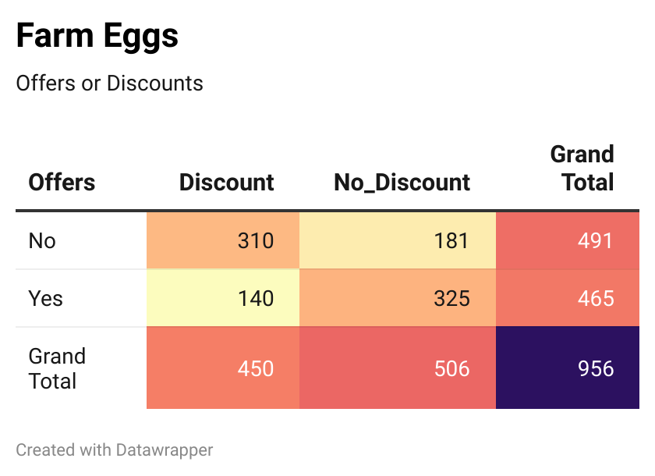
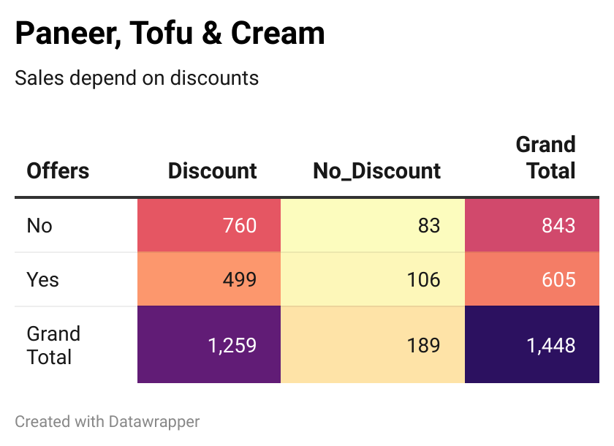
HEATMAPS FOR SALES PATTERN
Eggs, Meat & Fish
Bakery, Cakes & Dairy

Slide 20
The Dashboard will help us take a better look at strategies for growth in low sales categories
Team 6

Slide 21
USEFUL LINKS
Rating Predictor:
Link for Streamlit app
Technical Appendix:
Link for Colab file
Recommendation System:
Link for Streamlit app
Team 6

